Slide 1
Microprocessors and Assembly language Lectures Volume-2
A.H.M. Asadul Huq, Ph.D.
EEE, University of Dhaka
Get course materials from the following link
http://asadul.drivehq.com/students.htm
Note: The password: cse.uap@univdhaka.edu

Slide 2
Computer Hardware Organization
CPU
Registers
RAM | ROM
program
data
storage
storage
Control, data, address bus
ALU
Control
unit
output
input
unit
unit

Slide 3
Arithmetic Logic Unit (ALU)
ALU does all arithmetic and logical operations
ALU receives data from registers/memory and performs the task
ALU writes the result back to register/memory
Types: Integer & Floting Point(earlier Math co-processor)
Modern processors contain more than one integer ALU and Floting point ALU

Slide 4
Control unit
Contains hardware instruction logic
Decodes and monitors execution of instructions
CPU
Registers
RAM | ROM
program
data
storage
storage
Control, data, address bus
ALU
Control
unit
output
input
unit
unit

Slide 5
Control Unit Continued ...
Types: Microprogram & Hardware
RISC(Reduced Instruction Set Computer) uses Hardware control unit; faster execution
CISC (Complex Instruction Set Computer) uses Microprogram control unit; easy to program

Slide 6
System Bus
Wires through which data and information are interchanged between units
Three types of bus (more later):
- Address bus - Data bus - Control bus
CPU
Registers
RAM | ROM
program
data
storage
storage
Control, data, address bus
ALU
Control
unit
output
input
unit
unit

Slide 7
Intel 8086
Processor: 16-bit
Data bus: 16-bit
Address bus: 20-bit (address up to 1MB)
Control bus: 16-bit
Number of 16-bit registers: 14
Power supply: +5V (single)
Clock speed: 5 MHz (8086), and 10 and 8 MHz (8086-1, 8086-2)
Pin: 40 pin IC
Design: using HMOS technology (29,000 transistors)
Design: using HCMOS technology (80C86A, low power ver.)

Slide 8
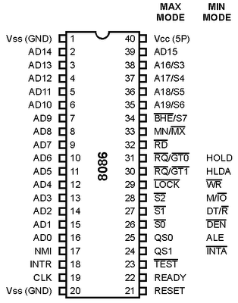
8086 pin configuration

Slide 9
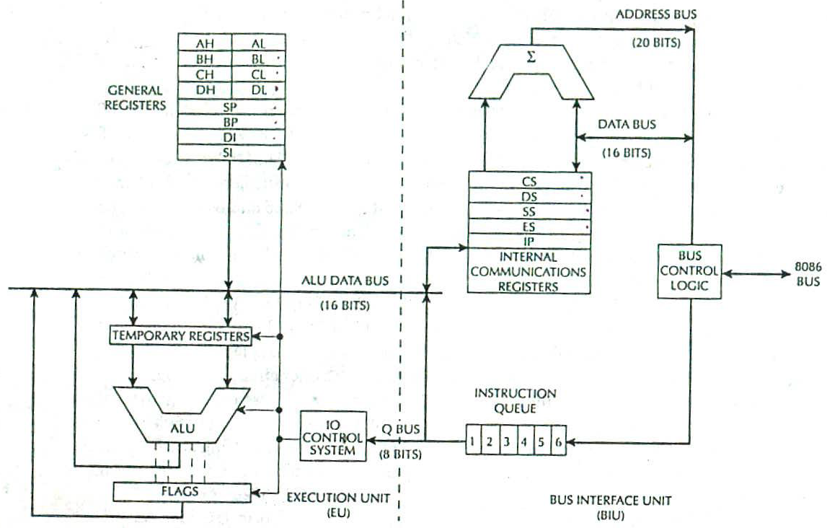
8086 Block diagram

Slide 10
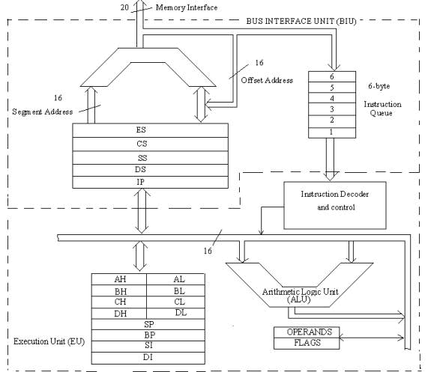
8086 Block diagram

Slide 11
Internal Functional Unit of 8086
Bus Interface Unit (BIU):
Fetch instructions from memory, and read/write data from memory and I/O ports.
Execution Unit (EU):
Execute instruction that have already been fetched by BIU.
The BIU and EU function independently

Slide 12
Bus Interface Unit (BIU)
Segment registers
Code segment register (CS)
Data segment register (DS)
Stack segment register (SS)
Extra segment register (ES)
Instruction pointer (IP)
Instruction queue (IQ)
6 Bytes length (FIFO)
Address generation unit:
Generate 20-bit physical address
Bus control logic unit:
Generate all bus control signals such all read/write signals for memory and I/O.

Slide 13
Execution Unit (EU)
General purpose registers
AX ---AH +AL
BX---BH +BL
CX---CH+CL
DX---DH+DL
Pointer registers
Base pointer register (BP)
Stack pointer register (SP)
Index register registers
Source index register (SI)
Destination index register (DI)
ALU
Temporary register
Flag register
IO Control system

Slide 14
8085 VS 8086
1. Size:- 8085 is 8 bit microprocessor whereas 8086 is 16 bit microprocessor.
2. Address Bus:- 8085 has 16 bit address bus and 8086 has 20 bit addres bus.
3. Memory:- 8085 can access upto 2^16 = 64 Kb of memory whereas 8086 can access upto 2^20 = 1 MB of memory.
4. Instruction Queue:- 8085 doesn't have an instruction queue whereas 8086 has instruction queue.
5. Pipelining:- 8085 does not support pipelined architechture whereas 8086 supports pipelined architechture.
6. Multiprocessing Support:- 8085 does not support multiprocessing support whereas 8086 supports.

Slide 15
8085 VS 8086 Continued ..
8. Arithmetic Support:- 8085 only supports integer and decimal whereas 8086 supports integer, decimal and ASCII arithmetic.
9. Multiplication and Division:- 8085 doesn't support whereas 8086 supports.
10. Operating Modes:- 8085 supports only single operating mode whereas 8086 operates in two modes.
11. External Hardware:- 8085 requires less external hardware whereas 8086 requires more external hardware.
13. Memory Segmentation:-In 8085, memory space is not segmented but in 8086, memory space is segmented.
14. Clock Speed:- clock speed of 8085 microprocessor is 3 MHz whereas clock speed of 8086 microprocessor vary between 5,8 and 10 MHz for different versions.
15. Flags:- 8085 has 5 flags & 8086 has 9 flags

Slide 16
WHAT IS COMPILER, ASSEMBLER AND INTERPRETER ?
Compiler : A Compiler is a computer program that is used to convert a high level language (like C, C++ , C#, Scala) program and translates it as a whole into the machine code .
Example : gcc , Microsoft Visual Studio
Assembler : An Assembler is a computer program that is used to convert assembly language code into machine code.
Examples : Visual MASM (easy to use IDE available for assembly programmers)
Interpreter : An interpreter is a computer program which translates statements of a high level language program one by one directly at runtime.
Examples: python, Ruby, PHP, Java
Note: IDE- An integrated development environment is a software suite that consolidates basic tools required to write and test software

Slide 17
Memory (RAM & ROM)
Memory is an array of storage, each having capacity of 8 bits and holds machine code of instruction or data in binary format
Each location is uniquely identified by a number/code, starting from ‘0’, called Address, usually represented in Hexadecimal form
Memory is byte addressable
RAM temporarily holds machine codes (binary) of instructions/programs to be executed
RAM also holds data (binary coded) required in a program
ROM holds boot-up programs, BIOS

Slide 18
Memory: RAM
Random Access Memory (RAM)
SRAM: static RAM – uses bipolar transistors (4-6) and very fast but expensive
DRAM: dynamic RAM – uses one transistor and one capacitor – information stored in capacitor – periodic refresh operation required

Slide 19
Memory: ROM
Read Only Memory (ROM)
Mask-programmed read-only memory (MROM): programmed when being manufactured
Programmable read-only memory (PROM): the memory chip can be programmed by the end user
EPROM: programmable memory that can be erased
EEPROM: programmable memory that can be erased by electrical signals and reprogrammed

Slide 20
Memory Address and Capacity
Example: 1MB (Byte!): Nearly 1 Million locations each having capacity of 1Byte
Addresses are encoded in BINARY
In Binary, first address requires 1 bit (0) and final addressable location requires 20 bits (all 1’s: 11…11), since 2²⁰ ⁼ 1M
For ease of Decoder design, uniform address format is used for all the locations; Maximum number of bits!
For convenience/ease of representation/programming/discussion, Hexadecimal number system is used to represent Memory address

Slide 21
Address of Memory (1MB)
Address (20 bits in binary) | 8-bit Content Example
11111111111111111111 _{B} | 11001100 (machine code/data)
…
00000000000000000000 _{B} | 00110101(machine code/data)
Address (5 digits in hexadecimal) | Content(8 bits)
FFFFF _{H} | 11001100 (machine code/data)
..... | .....
00000 _{H} | 00110101(machine code/data)

Slide 22
How a program is stored in Main Memory?
Contents
Address of Main Memory
500….H | Instruction-N (Machine Code)
 | ….
50002H | Instruction-3(Machine Code)
50001H | Instruction-2(Machine Code)
50000H | Instruction-1 (Machine Code)
300…H | Data-N (in binary)
… | …
30001H | Data-1 (in binary)
30000H | Data-1 (in binary)

Slide 23
Registers
Register is a storage location in the CPU
Used to hold data/address during execution of an instruction
Registers have faster access time than main memory
Number of registers available for programming varies from μP to μP

Slide 24
Registers continued ...
Size: 4 bits/8 bits/16 bits/32 bits/64 bits/128 bits…
For Math Co-processor/Floating Point Units(FPU) registers are larger in size(bits)
In modern processors: Register size and number both are increasing
Register types: General purpose & special purpose
Must know register architecture for Assembly Language Programming
Since registers are few in numbers, they are addressed by Names in Assembly language Programs
Naming depends on processor series, usually upper case one/two/three letters are used. Example: A, AX, EAX etc

Slide 25
Types of Registers
General purpose: Holds data to be used in ALU. Also holds partial results or final results generated by ALU.
Special Purpose:
Holds address of main memory locations where instructions are loaded by Operating system.
Holds address of main memory locations where data are stored
Holds address of main memory locations used for special purposes
Holds machine code of Instructions
Holds status of CPU

Slide 26
How a program runs?/ How does a Microprocessor work?
A program is a list of Instructions
Operating system loads the program/list of Instructions onto RAM in consecutive locations starting from a particular point.
CPU/Microprocessor Reads/Fetches Instructions one by one and Executes till the end of the list.

Slide 27
How a program runs?/How does a Microprocessor work?
Operating system loads the program/list of Instructions onto RAM in consecutive locations starting from a particular location.
500….H | Instruction-N (Machine Code)
 | ….
50002H | Instruction-3(Machine Code)
50001H | Instruction-2(Machine Code)
50000H (starting Address) | Instruction-1 (Machine Code)
300…H | Data-N (in binary)
… | …
30001H | Data-1 (in binary)
30000H | Data-1 (in binary)

Slide 28
How a program runs?/How does a Microprocessor work?
The address of the first instruction/starting address 50000H is also loaded into a register, called Program Counter (PC) by OS.
Microprocessor places the content of PC/address of instruction (50000H) onto Address Bus.
Memory location at 50000H is activated by address decoder associated with memory device.
Microprocessor sends Read control signal to main Memory. As a result, content of memory location 50000H is transferred into a Register within Microprocessor through data bus.
The Machine code of first instruction is, thus, Read/collected/fetched by the processor from Main Memory.

Slide 29
How a program runs?/How does a Microprocessor work?
The Machine code of first instruction is then passed to the control unit for decoding.
In the meantime, Program Counter is automatically incremented by 1 (50001H) to point next instruction to be fetched.
ALU/other operation indicated by first instruction are performed/executed.
Microprocessor places the content of PC/address of next instruction (50001H) onto Address Bus and similar steps are repeated till the last instruction of the program is executed.

Slide 30
Program counter(PC)
Register within CPU
Holds the address of the next instruction to be fetched from memory
Goes through step by step counting sequence - causes the computer to read successive instruction stored in memory
PC is modified with new address when there is a jump or transfer or subroutine call instruction
See following figure

Slide 31
Program counter (PC)
CPU
Program memory
Data memory
A
Stack
B
Status register
IX
SP
PC
Control, data, address bus
ALU
Control unit

Slide 32
Status register
After an ALU operation following can occur
-carry/borrow for addition/subtraction
-overflow
-result zero, negative or positive
Register which contains flags to indicate these status of any processor operation
Programmer can use these status condition for program control

Slide 33
Flags
Carry flag
0 0 1 1 0 1 0 1
0 1 0 0 0 0 1 1
0 0 1 1 1 1 0 0 0
1 0 0 0 0 0 1 0
1 0 1 0 0 0 1 1
1 0 0 1 0 0 1 0 1
Carry 0
Carry 1

Slide 34
Index register
Almost all μPs have an index register
Holds a base address to be added to an offset
Base address and the offset forms the effective address

Slide 35
Index register Example
Effective address
Program
memory
CPU
Data
memory
A
Offset
address
B
Status register
+
Base address
Stack
IX
SP
PC
Control, data, address bus
ALU
Control unit

Slide 36
Stack pointer (SP)
An area of RAM used for temporary storage of data/return address is called stack
SP is a register within CPU that points to the next free location on the stack
Each time a byte is put onto stack, SP is decremented
Each time a byte is retrieved from stack, SP is incremented
figure showing an example

Slide 37
Stack pointer continued ..
CPU
Program memory
Data memory
A
Stack
B
Status register
IX
SP
PC
Control, data, address bus
ALU
Control unit

Slide 38
Stack pointer continued ...

Slide 39
Stack pointer continued...

Slide 40
How Program code and Data is stored and accessed in main memory?
Unified/general approach: Any location can hold machine code or data except some area reserved for system information and operating system.
Segmentation: Main memory is logically divided into sections used for holding Program(machine codes of instructions), data to be used in program and other special purposes.

Slide 41
Memory Segmentation
In 8086, the total memory size is divided into segments of various sizes.
A segment is just an area in memory.
The process of dividing memory this way is called Segmentation.
Memory has four different types of segments. These are:
Code Segment
Data Segment
Stack Segment
Extra Segment

Slide 42
Memory Segmentation-2
The code segment is used to store the program code. The segment can also store program instructions and data. segments generally stores data used in the program.
The Data, Stack and Extra
Each of the segments are pointed to (addressed) by 4 segment registers called CS, DS, SS and ES. respectively.
Each segment register stores the Base (starting) address of the corresponding segment

Slide 43
Memory Segmentation-3
The segment registers are 16-bit in size.
Because the segment registers cannot store 20 bits, they only store the upper 16 bits.
The 20-bit address of a byte in memory is called its Physical Address. But, it is specified as a Logical Address.
Logical address is in the form of- Base Address : Offset
Offset is the displacement of the memory location from the starting location of the segment.
Segmentation helps to increase the speed of execution so that processor can able to fetch and execute the data from the memory even faster and easily.

Slide 44
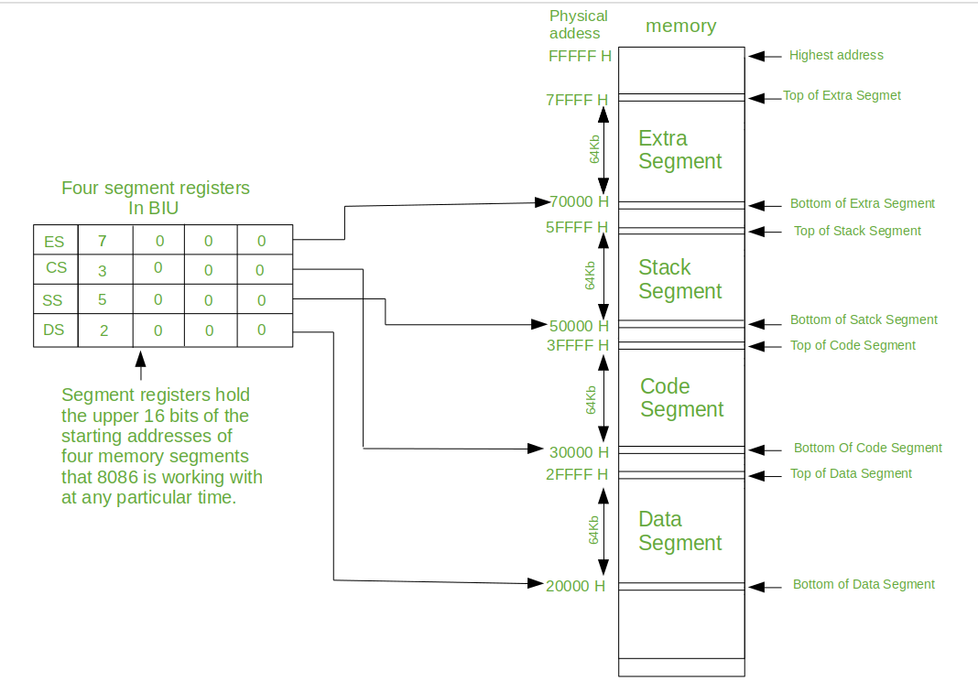
Memory segmentation

Slide 45
How The Physical Address is Calculated
8086's BIU produces the 20-bit physical memory address by combining a 16-bit segment address with a 16-bit offset address.
There are four 16-bit segment registers, viz., the code segment (CS), the stack segment (SS), the extra segment (ES), and the data segment (DS). These segment registers hold the corresponding 16-bit segment addresses. A segment address is the upper 16-bits of the starting address of that segment.
The lower 4-bits of the starting address of a segment is always zero.
The offset address is held by another 16-bit register. The physical 20-bit address is calculated by shifting the segment address 4-bit left and then adding that to the offset address.

Slide 46
Example of Calculation of Physical Address
Code segment Register CS holds the segment address which is 4569 H
Instruction pointer IP holds the offset address which is 10A0 H
The physical 20-bit address is calculated as follows -
(4569h * 10h + 10A0h = 12345h)
Segment address : 45690 H
Offset address : + 10A0 H
---------------------------------------------------
Physical address : 46730 H

Slide 47
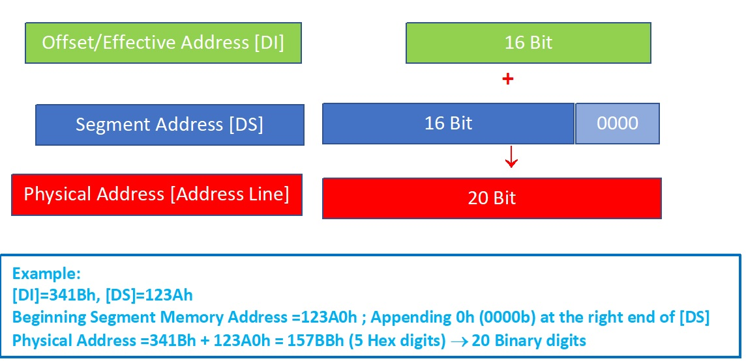
Calculation of Physical Address

Slide 48
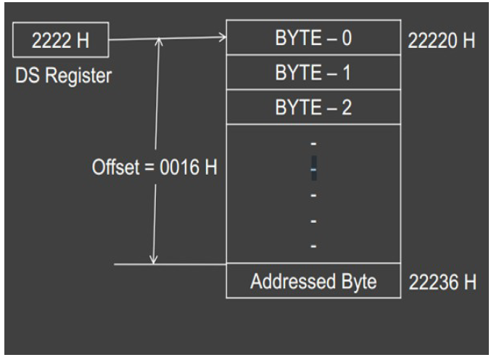
Diagram of Physical Address Calculation

Slide 49
Instruction set
To program a μP, a variety of data manipulation, arithmetic and logical instructions are featured for a processor
Instructions can be organised into functional groups-
-Data movement -Arithmetic
-Logical -Bit manipulation
-Shift/rotate -Branch/Jump
-Subroutine call -Interrupt handling
-Miscellaneous

Slide 50
Addressing modes
To perform an operation, operands are to be supplied
Operands can come from registers, memory locations or directly as part of an instruction
Addressing mode says from where the operands come from
Very common addressing modes are
-Immediate, direct, inherent, relative, indexed (more detail later)

Slide 51
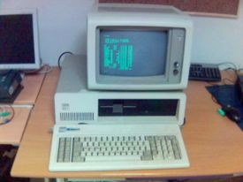
Intel microprocessors and Applications
Intel 8080 (1972)
64K addressable RAM
8-bit registers
CP/M operating system
5,6,8,10 MHz
29K transistros
Intel 8086/8088 (1978)
IBM-PC used 8088
1 MB addressable RAM
16-bit registers
16-bit data bus (8-bit for 8088)
separate floating-point unit (8087)
used in low-cost microcontrollers now

Slide 52
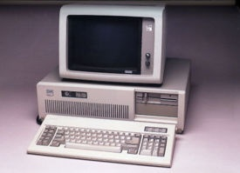
The IBM-AT
Intel 80286 (1982)
16 MB addressable RAM
Protected memory
several times faster than 8086
introduced IDE bus architecture
80287 floating point unit
Up to 20MHz
134K transistors

Slide 53
Intel Architecture IA-32 Family
Intel 386 (1985)
4 GB addressable RAM
32-bit registers
paging (virtual memory)
Up to 33MHz
Intel 486 (1989)
instruction pipelining
Integrated FPU
8K cache
Pentium (1993)
Superscalar (two parallel pipelines)

Slide 54
Intel P6 Family
Pentium Pro (1995)
advanced optimization techniques in microcode
More pipeline stages
On-board L2 cache
Pentium II (1997)
MMX (multimedia) instruction set
Up to 450MHz
Pentium III (1999)
SIMD (streaming extensions) instructions (SSE)
Up to 1+GHz
Pentium 4 (2000)
NetBurst micro-architecture, tuned for multimedia
3.8+GHz
Pentium D (2005, Dual core)

Slide 55
Intel Architecture (IA) 32-bit Processors
Totally Dominate Computer Market
Evolutionary Design
Starting in 1978 with 8086
Added more features as time goes on
Still support old features, although obsolete
Complex Instruction Set Computer (CISC)
Many different instructions with many different formats
But, only small subset encountered with Linux programs
Hard to match performance of Reduced Instruction Set Computers (RISC)
But, Intel has done just that!

Slide 56
Addressable memory
Protected mode
4 GB
32-bit address
Real-address and Virtual-8086 modes
1 MB space
20-bit address

Slide 57
A Few Terms & Questions
Instruction, Machine Codes, Hex codes
Memory Address & Port Address
Instruction Processing: Fetch and Execution

Slide 58
Microprocessors Vol - 2
END
Get course materials from the following link
http://asadul.drivehq.com/students.htm
Note: The password: cse.uap@univdhaka.edu

